Slide 1
DESIGN & TECHNOLOGY- PRODUCT DESIGN
Paper 2
What's assessed
Designing and making principles
How it's assessed
• Written exam: 1 hour and 30 minutes
• 80 marks
• 20% of A-level
Questions
Mixture of short answer and extended response questions.
Section A:
• Product Analysis: 30 marks
• Up to 6 short answer questions based on visual stimulus of product(s).
Section B:
• Commercial manufacture: 50 marks
• Mixture of short and extended response questions
Paper 1
What's assessed
Technical principles
How it's assessed
• Written exam: 2 hours and 30 minutes
• 120 marks
• 30% of A-level
Questions
Mixture of short answer and extended response.
Non-exam assessment (NEA)
What's assessed
Practical application of technical principles, designing and making principles.
How it's assessed
• Substantial design and make project
• 100 marks
• 50% of A-level
Evidence
Written or digital design portfolio and photographic evidence of final prototype.

Slide 2
DESIGN & TECHNOLOGY- PRODUCT DESIGN
Year 12-
Theory- materials, properties, design movements and processes
NEA Preparation- Mock NEA with focussed practical tasks to support theory including practical and designing
Year 13-
Theory- revisit knowledge from Yr12, social and economic factors, design philosophy and manufacture
Full NEA- Context decided by student (has to solve a genuine problem)

Slide 3
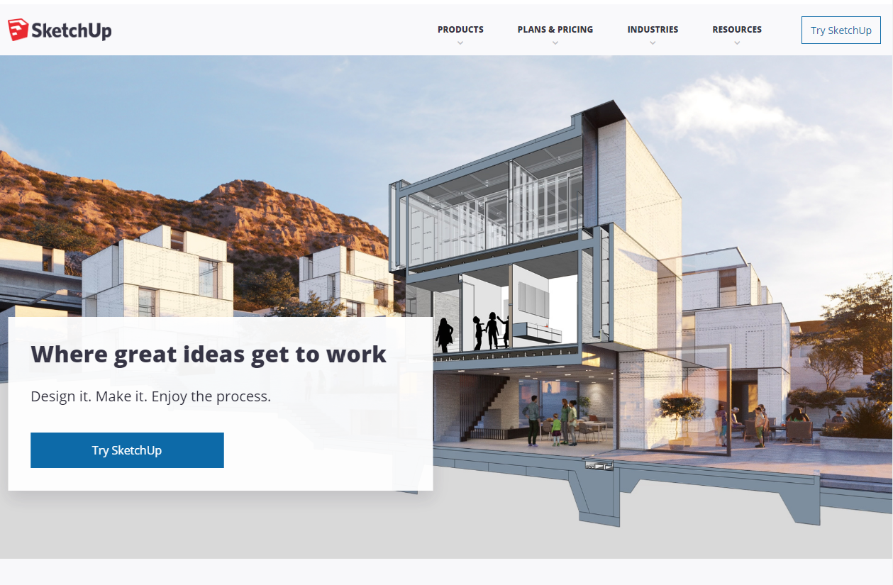
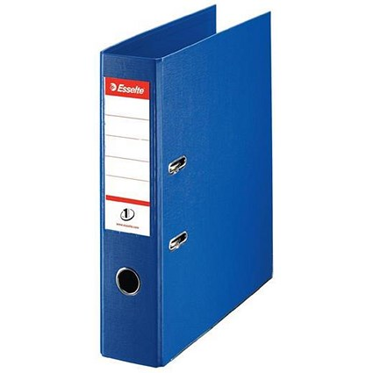
Preparation
Google SketchUp (essential)
Please search Google SketchUp on the internet and set up a free account to use it. All you need is an email address. You do not need to sign up to the paid version!
Folders (essential)
You will require an A4 lever arch file to keep notes in. Please also have a pad of A4 lined note paper within this.
You may also optionally wish to purchase an A3 folder to carry your sketch pad and equipment in. Although not compulsory this will ensure you can keep your work and equipment safe.

Slide 4
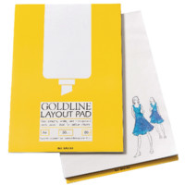
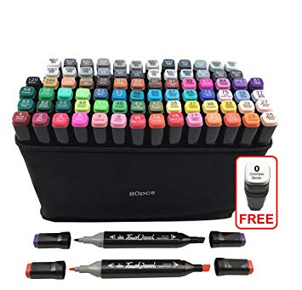
Preparation
Sketch pads (optional)
You will require an A3 sketch pad. If you can (although not essential) purchase a layout pad as this works better with markers. Pencils & Pens (essential)
You will require standard HB or other pencils to sketch with. You will also find it useful to have a set of good quality colour pencils which should include a white pencil if possible.
You will require a set of fine liners for sketching.
Markers (optional)
You will require a set of markers for rendering. You will need ‘Cool Grey’ Graphic markers and if possible, colour graphic markers. These are graphic markers not felt tips!

Slide 5
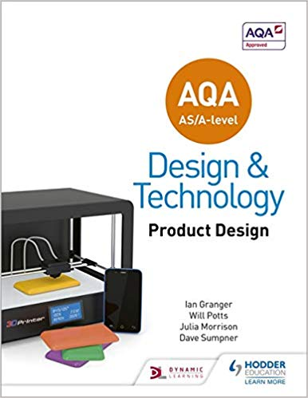
Textbook (essential)
You must have a copy of the following AQA textbook to support your studies-
Title: AQA AS/A Level Design & Technology: Product Design
Authors: Ian Granger, Will Potts, Julia Morrison and Dave Sumpner
Publisher: Hodder Education
ISBN: 9781510414082

Slide 6
Summer Project
To prepare you for the creative design element of the A level you are to complete the following project-
You are to redesign a commonly used product to improve an aspect of it. You will need to produce the following-
An overview of the product, what it is used for and the issues with the product.
Produce a set of sketches that show how the product can be further developed to resolve the faults identified.
Produce a final drawing that shows the refined product including annotations outlining the improvements.

