Slide 1
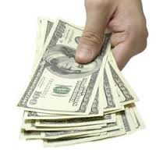
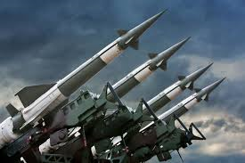
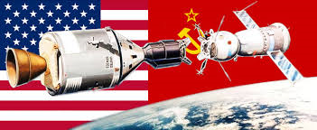
Use the images below, and your own knowledge, to give a definition of a “Cold War”.
Who was the Cold War between?
How would you characterise the Cold War?
Between what years did the Cold War take place?
How was the Cold War fought?
Challenge: Can you explain the differences between a “hot war” and a “cold war”?
Notes:
Mini white board activity.

Slide 2
Theme - Introduction

Slide 3
What were the early causes of the Cold War? Can we develop our own overview of key moments in the Cold War?
Key Topic 1: Why did the USA and USSR become rivals in the period 1941-49?
Keywords:
Superpower – a country or state that has great power and influence globally.
Ideology – A key set of ideas. The USA and the USSR had different ideologies about how a country should be governed and how its society should work.
International Relations – the relationships between countries
Rivalry - competition

Slide 4
https://www.youtube.com/watch?v=PHwIkOv6Rc4
Watch the video
How many of the features of war
does it show for the Cold War?
Identify the features of cold and hot wars

Slide 5
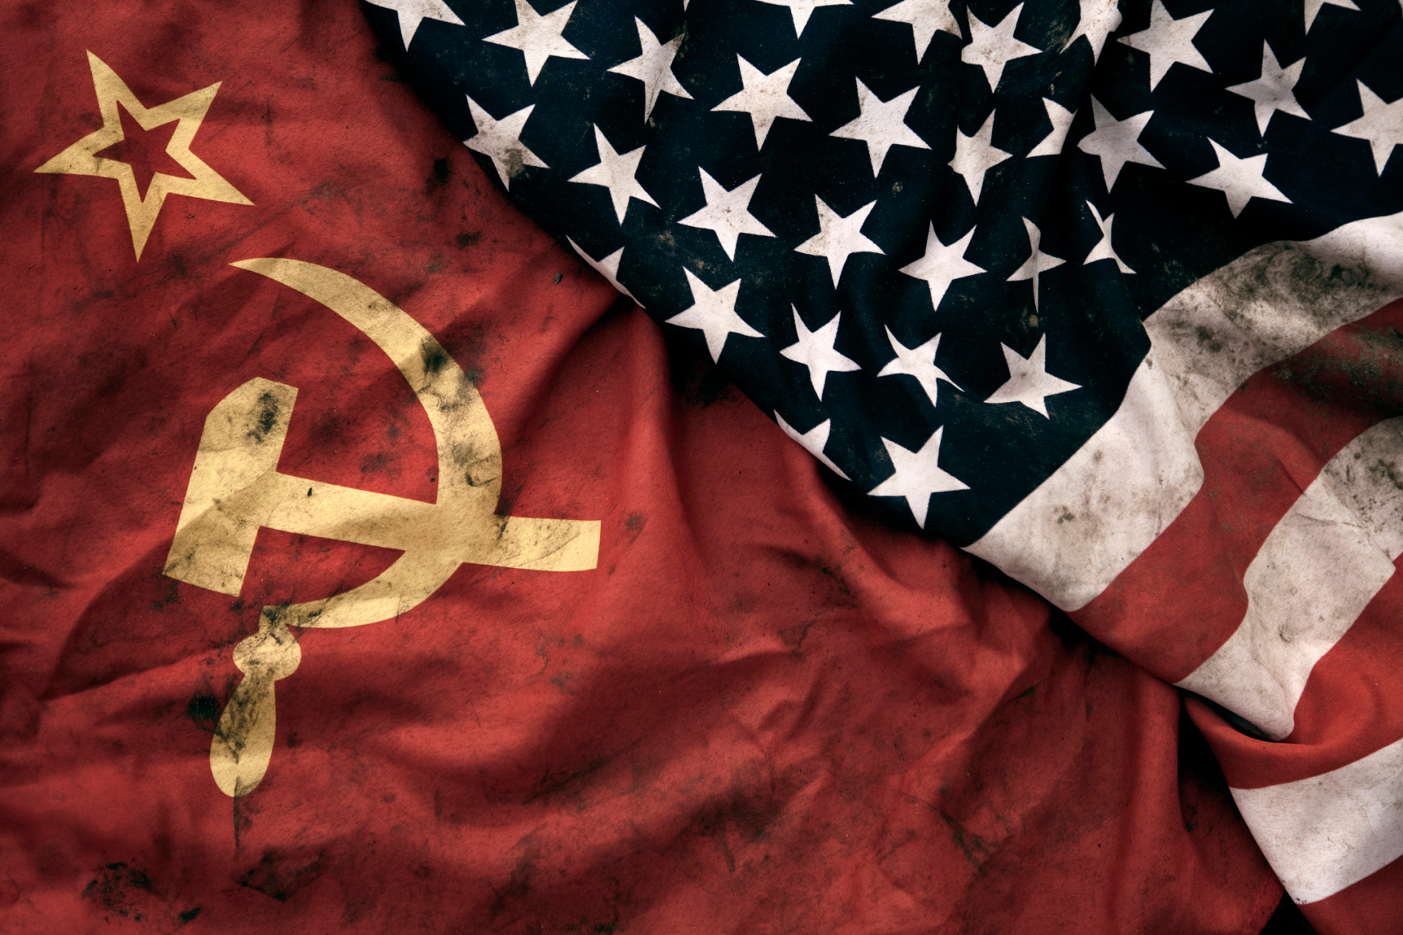
Communism + Capitalism
Key Topic 1: Why did the USA and USSR become rivals in the period 1941-49?
Task: Look at the Capitalism vs Communism worksheet – can you explain the difference in their economic systems?
Keywords:
Capitalism – capitalists believe everyone should be free to own property and businesses and make money.
Communism – Communists believe that all property, including homes and businesses, should belong to the state, to ensure that every member of society has a fair share.
Notes:
Pair work, leading to classroom discussion.

Slide 6
Different ideologies
Key Topic 1: Why did the USA and USSR become rivals in the period 1941-49?
Task - How would countries having these different ideologies cause tension?
Task - How might a communist country feel threatened by a capitalist country?
Notes:
Pair work, leading to classroom discussion.

Slide 7
Theme - Overview

Slide 8
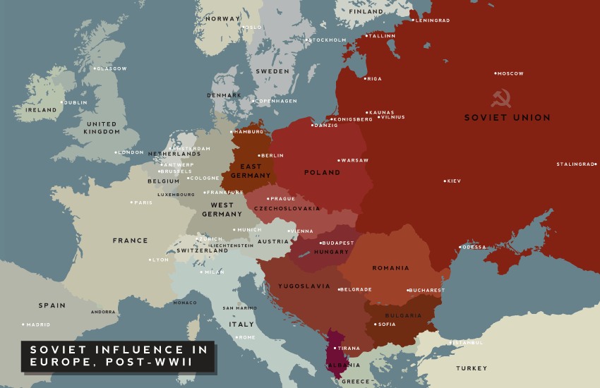

Slide 9
Task 1 – Design a timeline to give you an overview of events …. Follow the steps on the next few slides.

Slide 10
Step 1 – Who was in charge? Copy Stalin and Truman and find out the others before adding them to the line

Slide 11
Step 2 – What happened? Put the events on your timeline and add as much information as you can.

Slide 12
Step 2 – What happened? Put the events on your timeline and add as much information as you can.

Slide 14
Be creative – Now it’s time to show what you have learnt. For one of the events produce one of the following:

Slide 15
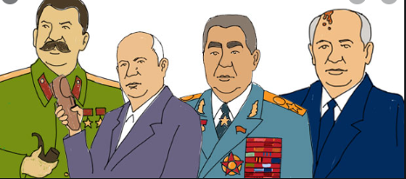
Task 2 – Soviet Leaders fact file Make a fact file/ biography about each of the Soviet Leaders Find out about: 1.Their name (include a picture if you wish) 2.The dates they were in power 3.What happened during their leadership (any key events) 4. Any of their key policies 5. Any interesting facts that you can find You can begin creating your fact file by listening to this video: https://www.youtube.com/watch?v=ASOzcjbKS6o

