Slide 1
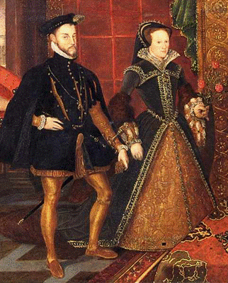
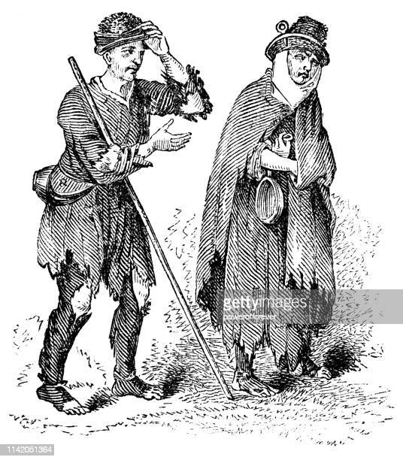
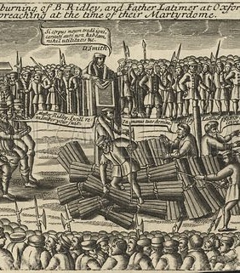
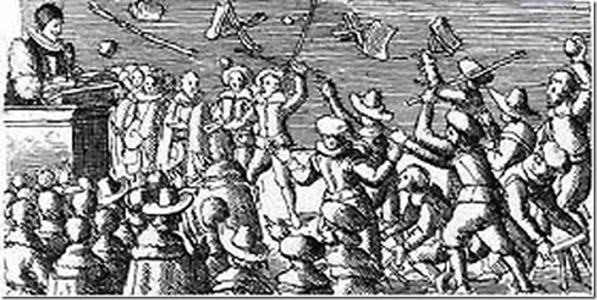
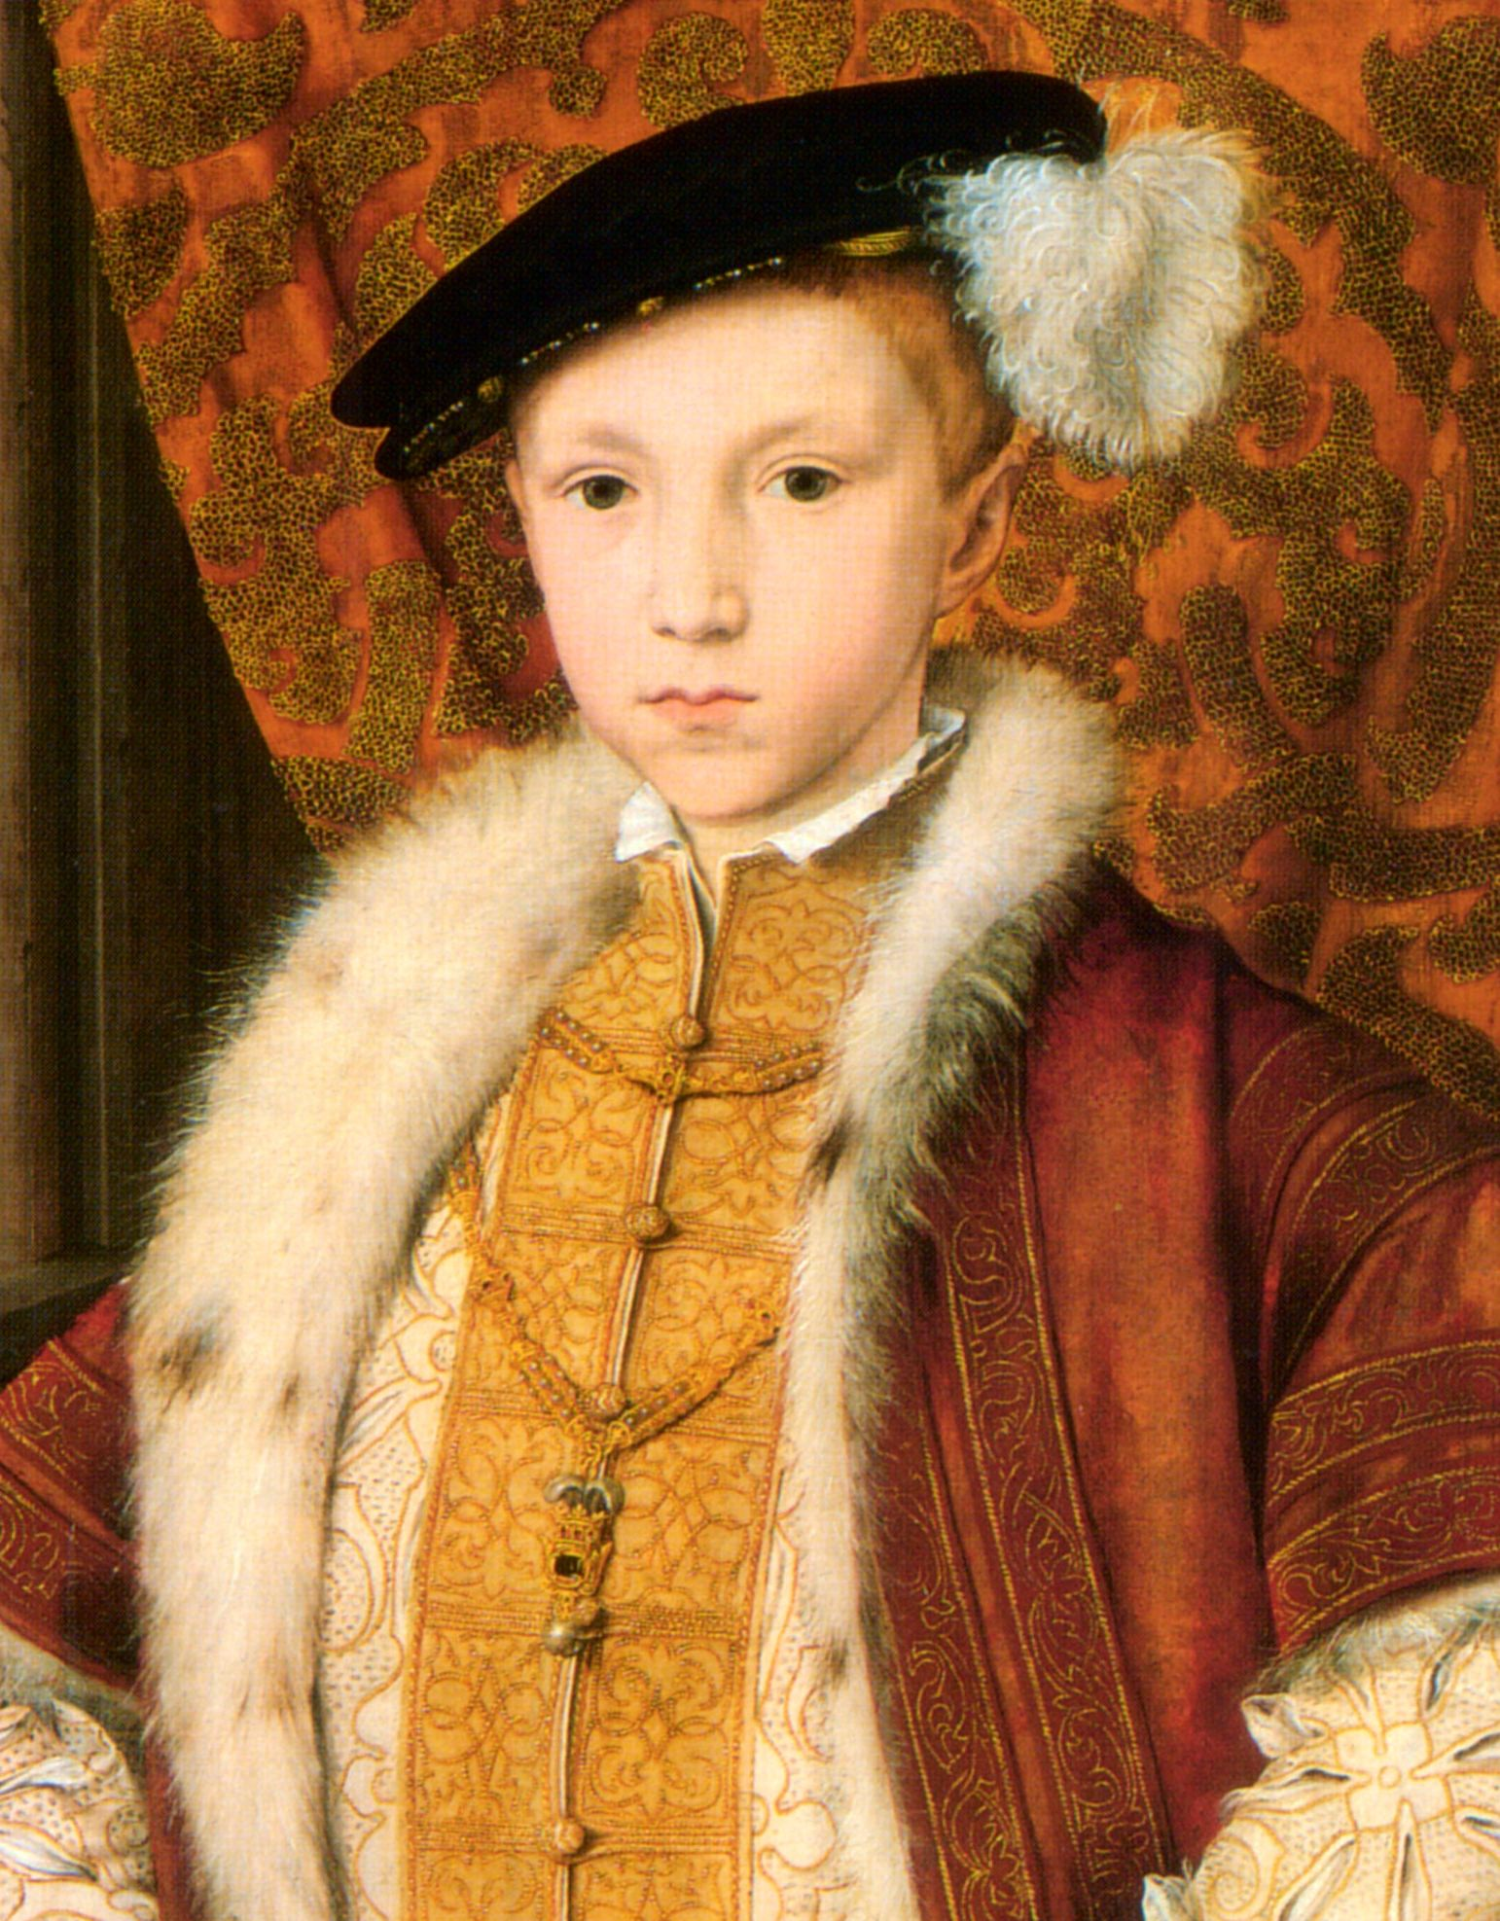
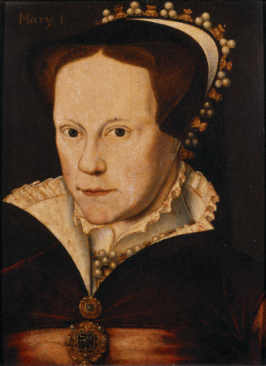
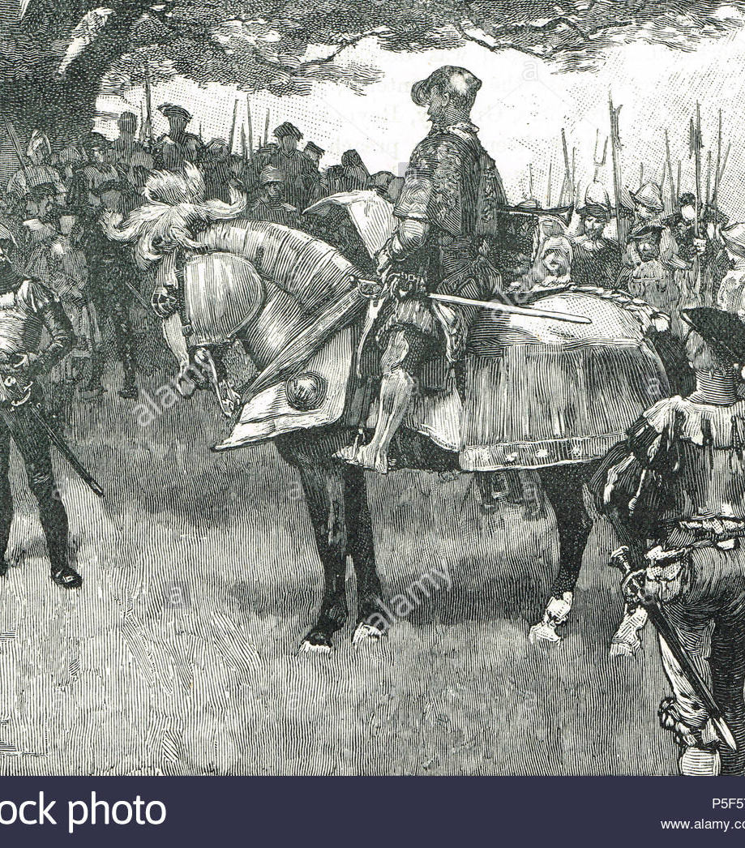
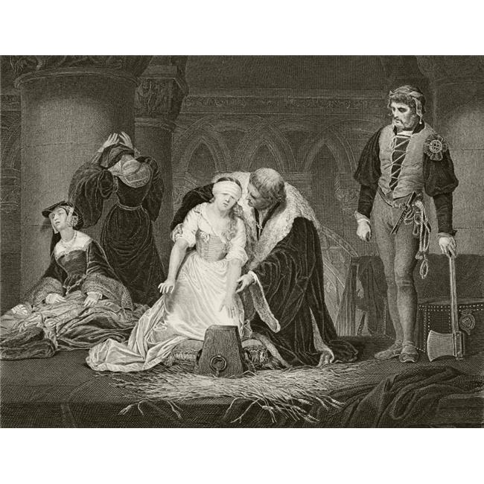
The mid-Tudor crisis
Use the images from this time to think about why this period has been called a ‘crisis’?

Slide 2
Summer Work – The mid-Tudor crisis

Slide 3


Activity 1
Read through the worksheet on the mid-Tudor crisis (pages 1-3)
Design a lesson that would be suitable for Year 7’s to teach them about why there was a ‘mid-Tudor crisis’
You will need to make it age suitable so that they will be able to understand it. If there are any difficult words, make sure they are explained.
Your design needs to be carried out on power point – perhaps one slide per person involved in the crisis in the chronological order it happened
Try to make it interesting, exciting, colourful and the information clear and concise

Slide 4

Activity 2
Read through the historiography section of the worksheet (page 4)
Make a summary diagram of all the key points presented by the Whig interpretation about the mid-Tudor crisis
Make a summary diagram of all the key point presented by more recent historians about the mid-Tudor crisis

Slide 5

Activity 3
One of the big reasons this period in history has been described as a crisis is because of the changes that took place in religion and because of the popular unrest that took place. In preparation of your study, it is important that you have some background to help you.
I would like you to carry out your own independent research on:
What were the differences between Catholicism and Protestantism in the 16th Century? Create a detailed list
What were the rebellions that took place during the time of Henry VIII, Edward VI and Mary I? Create a timeline of these rebellions

